Slide 1


SIGHT OF THE BLIND
Team – Amigos

Slide 2
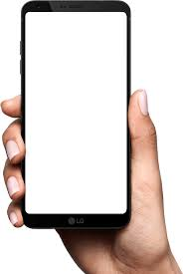




Slide 3

How visually impaired people access smartphones?

Slide 4
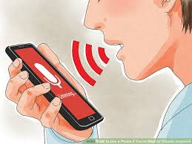
What about :
Privacy?
Noisy environment?
Voice command support for regional languages?

Slide 5
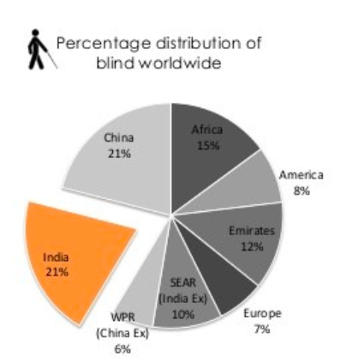
MOTIVATION
India is now home to the world’s largest number of blind people. Of the 40 million people across the globe who are blind, over 15 million are from India. What’s worse, 75% of these are cases of avoidable blindness.

Slide 6



Tough Problem?
Our Solution
BLINDOPHILE:
Innovating the tradition

Slide 7
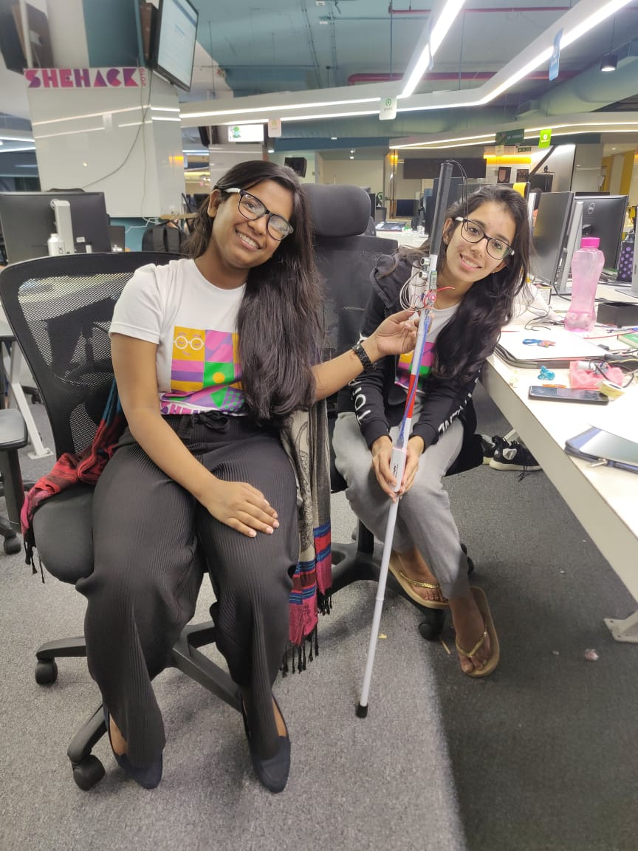

Half Victory Achieved

Slide 8
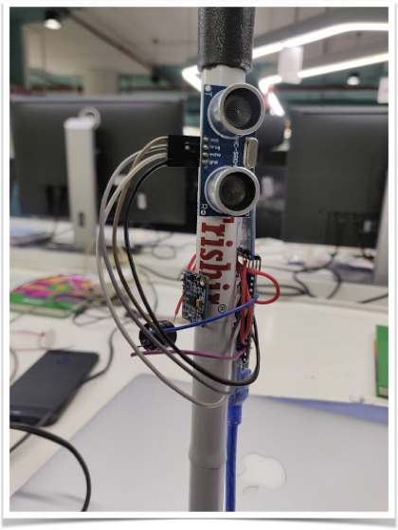
Ultrasonic Sensor
IMU Module
Buzzer

Slide 9
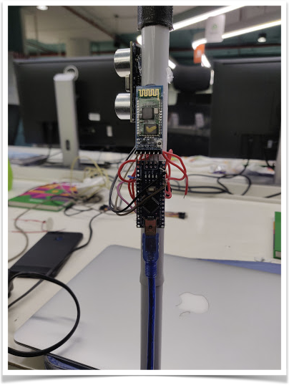
Bluetooth Module
Arduino Nano

Slide 10
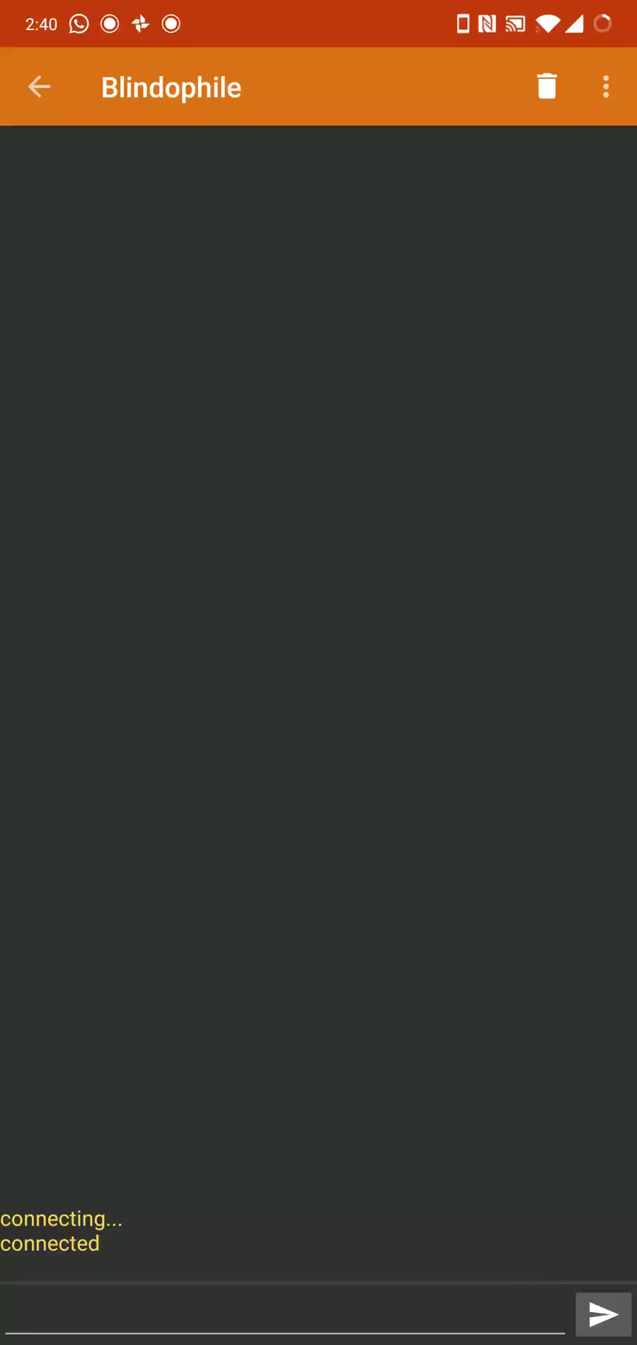
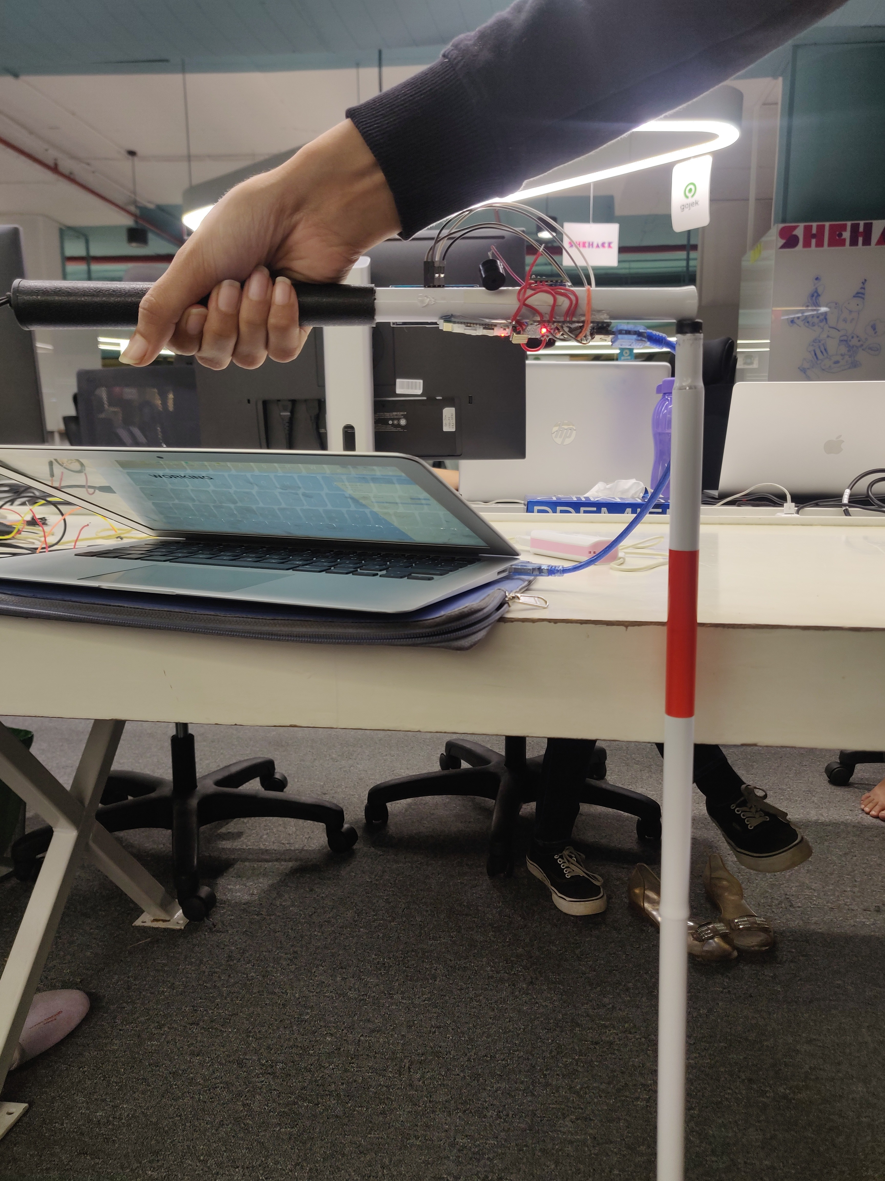
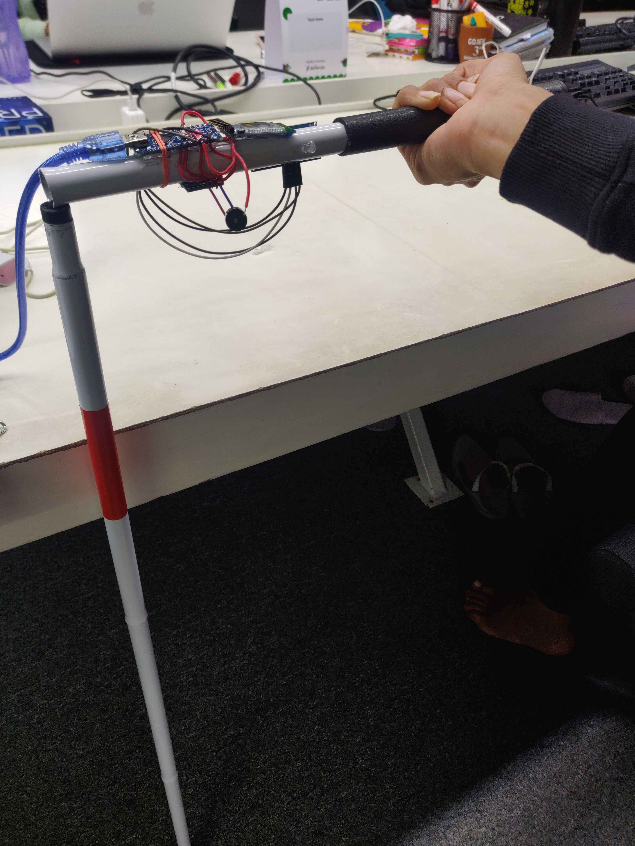
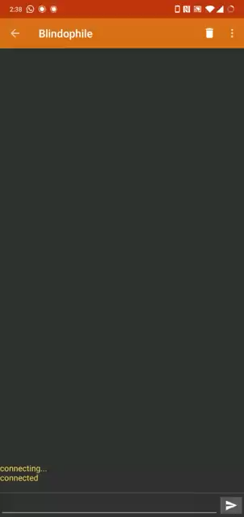
WORKING
Action 1 Triggered
GESTURE 1
Action 2 Triggered
GESTURE 2

Slide 11
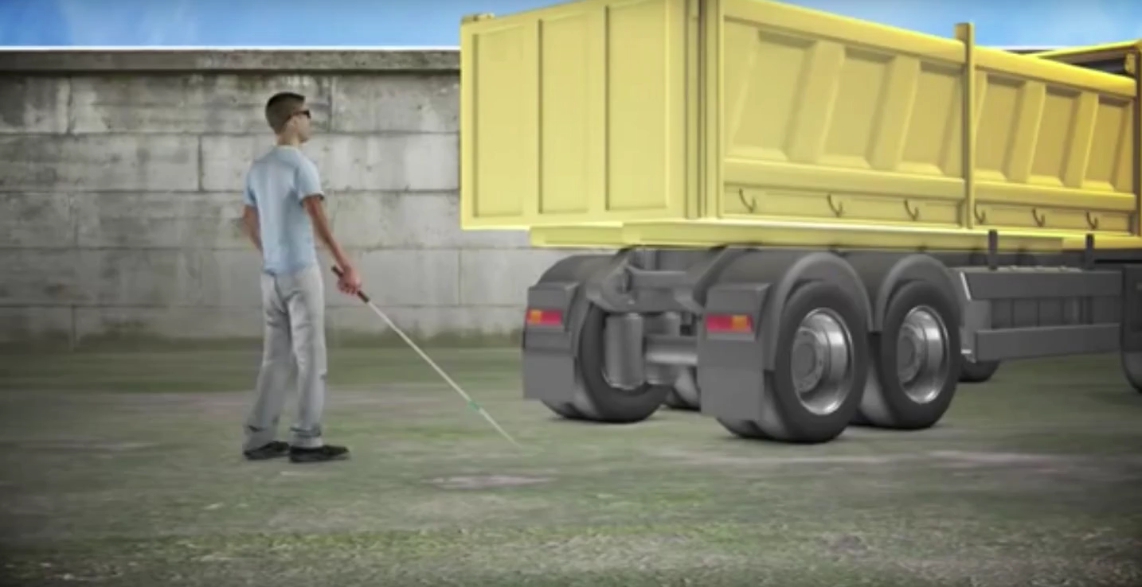
Problem: Traditional cane can't detect objects higher than the waist.
Solution: Our device emits ultrasound waves to detect nearby obstacles and buzzer beeps to warn the user of anything in its path.

Slide 12
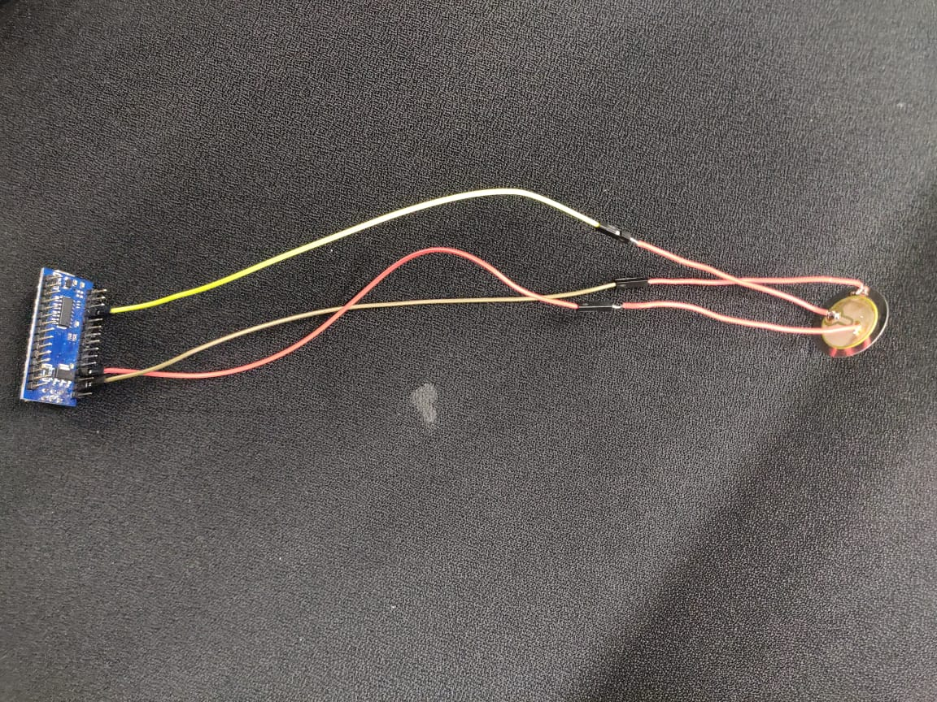
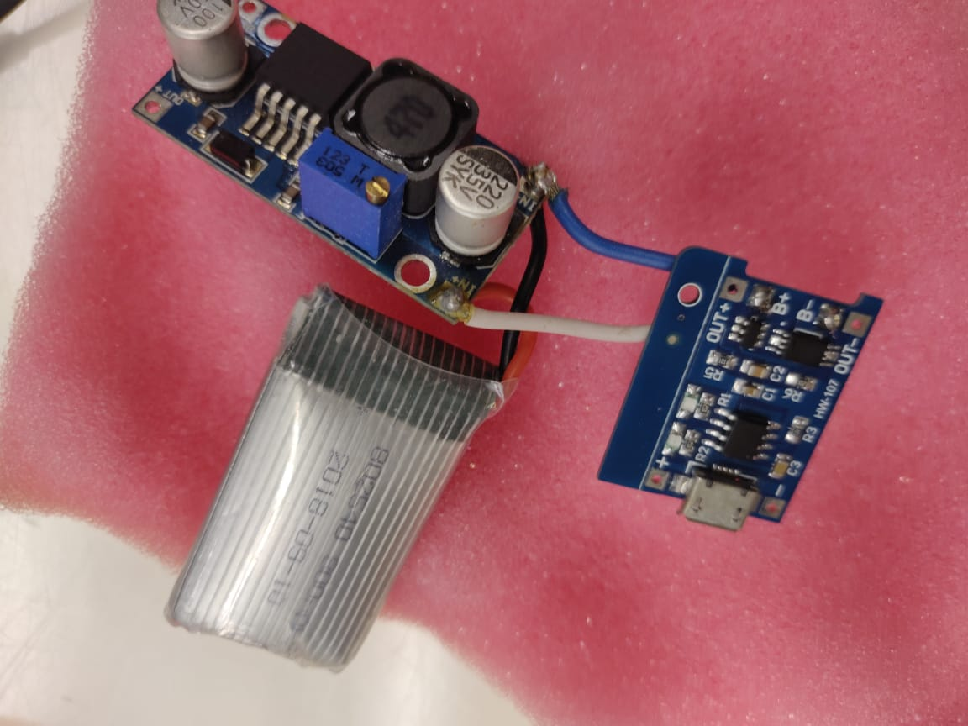
Challenges
Piezoelectric Sensor
Self Recharging Battery

Slide 13
Are you excited to see the demo?

